Slide 1


Keywords
Increase
Percent (%)
Fractions
Hundred
Parts
EQ: How do I do Percentage increases/decrease with a calculator?
DATE
Percentage Increase and decrease with a calculator
STARTER
Convert the following decimals into percentages:
0.29 0.67 1.56 0.623 0.03
Jack currently earns $27,700 per annum.
His boss now gives him a 14% pay rise.
Jill currently earns $30,250 per annum.
Her manager has awarded her a 3% pay rise.
After the pay rises, who will have the higher salary, and by how much?
Convert the following percentages into decimals:
43% 80% 159% 17.5% 5%
Depth
2.5
Convert the following decimal into a percentage
200%
Convert the following percentage into a decimal
Notes:
Go through in real time

Slide 2
Contents
Glossary or Formula Page
Page
Date
Essential Question
24
7
30
Word or Formula
Definition or Example

Slide 3
Tasks
24
7
30
Topic
Essential Question
Questions
Notes
Summary
1
2

Slide 4
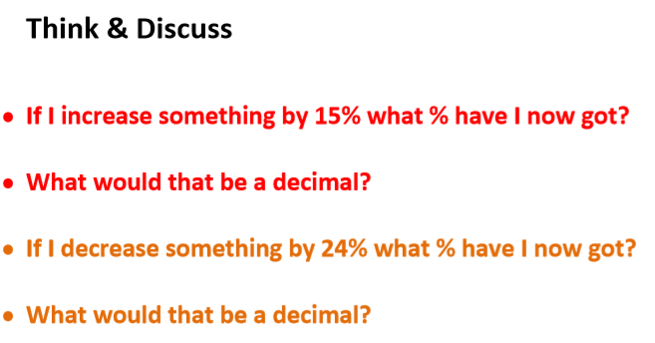
EQ: How do I do Percentage increases/decrease with a calculator?
Understanding

Slide 5
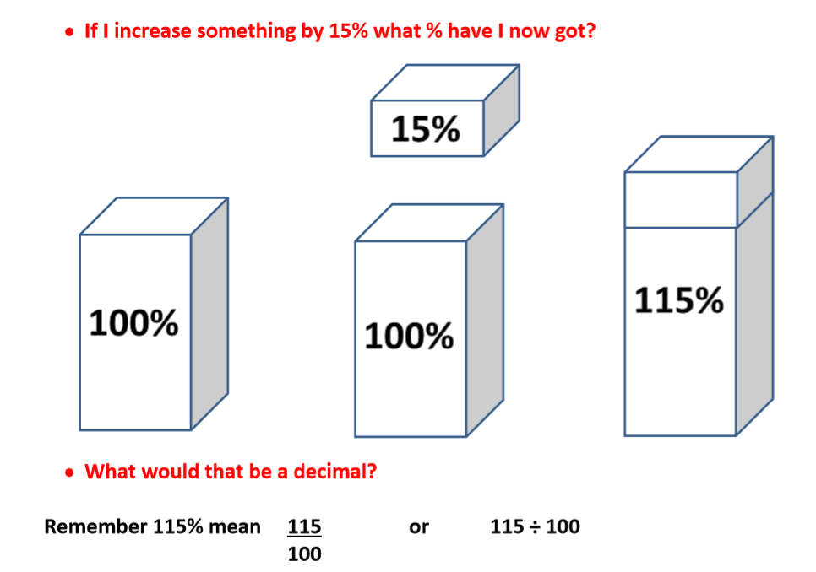
EQ: How do I do Percentage increases/decrease with a calculator?
Understanding

Slide 6
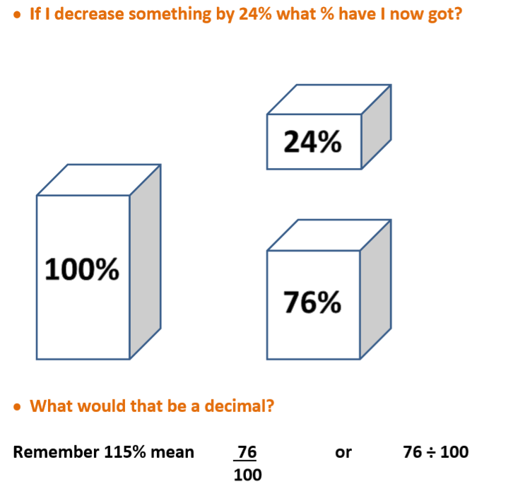
EQ: How do I do Percentage increases/decrease with a calculator?
Understanding

Slide 7
EQ: How do I do Percentage increases/decrease with a calculator?
Example
The original amount is always a whole = 1 = 100%.
So if we add on 12%,
we now have 112% of the original amount.
100% = 1
12% = 0.12
112% = 1.12
Therefore the decimal multiplier is 1.12.
And if we subtract 8%,
we have 92% of the original amount.
100% = 1
92% = 0.92
8% = 0.08
Therefore the decimal multiplier is 0.92.

Slide 8
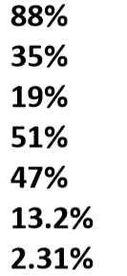
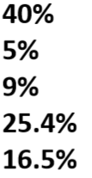
EQ: How do I do Percentage increases/decrease with a calculator?
Examples
Notes:
If students do well miss out next L slide

Slide 9

LO: Percentage increases/decrease with a calculator
Hinge Questions
Write down the decimal multiplier for these percentage changes:
To increase an amount by 15%
To decrease an amount by 40%
To raise an amount by 31%
To reduce a quantity by 9%
Taking away 49% from the original amount
Putting an extra 6.5% onto the initial quantity
Increase a quantity by 34.5%
Decrease an amount by 0.1%
Notes:
If studnets do well go straight to C&R worded questions if not next slide

Slide 10
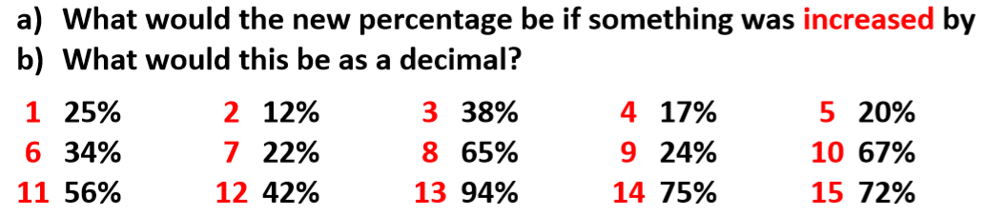
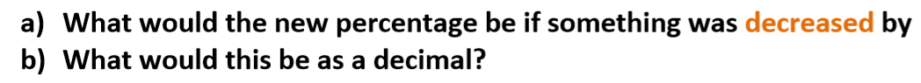
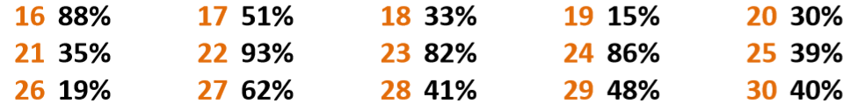
L
EQ: How do I do Percentage increases/decrease with a calculator?
Fluency and Understanding

Slide 11
EQ: How do I do Percentage increases/decrease with a calculator?
Examples
John bought a house two years ago for $ 220,000. The value has now increased by 28%. What is the price now?
As before, we can represent the original amount as 100% like this:
100% = 1
28% = 0.28
128% = 1.28
When we add on 28%,
we have 128% of the original amount.
So the decimal multiplier is 1.28.
128% of £220,000 = 1.28 × $ 220,000
= $ 281,600
Notes:
Go through in real time

Slide 12
EQ: How do I do Percentage increases/decrease with a calculator?
Examples
A pair of trainers originally costing $ 79 is reduced by 30% in a sale. What is the sale price?
As before, we can represent the original amount as 100% like this:
100% = 1
70% = 0.7
30% = 0.3
When we subtract 30%
we have 70% of the original amount.
So the decimal multiplier is 0.7.
70% of $79 = 0.7 × $79
= $55.30
Notes:
Go through in real time

Slide 13
EQ: How do I do Percentage increases/decrease with a calculator?
Your Turn
Increase $ 24 by 35%
Increase $86 by 18.5%
$ 24 x 135% =
$ 24 x 1.35
$86 x 118.5% =
$ 86 x 1.185
= $ 32.40
= $ 101.91
Decrease $ 56 by 34%
Decrease $ 320 by 3.5%
$ 56 x 66% =
$ 56 x 0.66
$ 320 x 96.5% =
$ 320 x 0.965
= $ 36.96
= $ 308.80

Slide 14
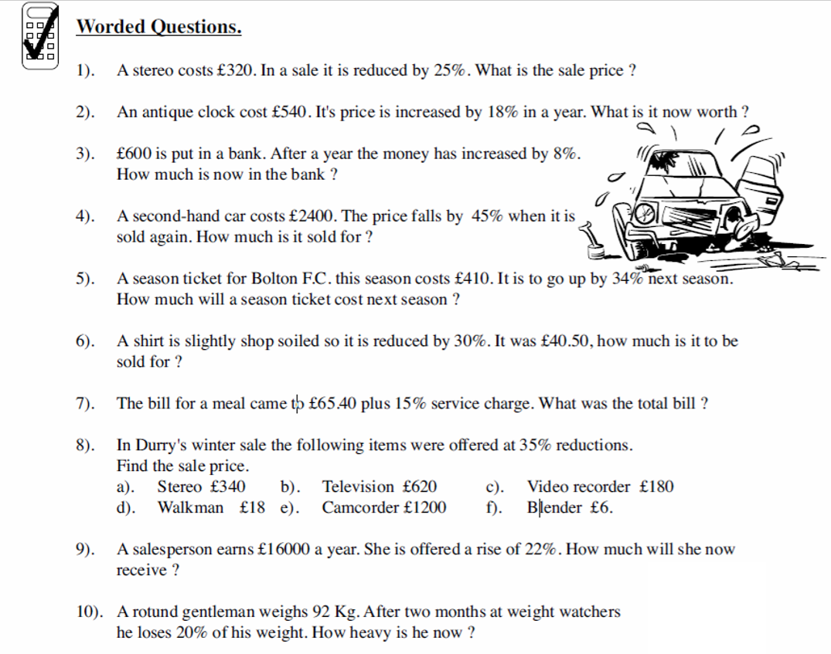
EQ: How do I do Percentage increases/decrease with a calculator?
Connections and Reasoning
1. £240
2. £637.20
3. £648
4. £1320
5. £549.40
6. £28.35
7. £75.21
8.
£221
£403
£117
£11.70
£780
£3.90
9. £19520
10. 73.6kg
Notes:
Go through in real time

Slide 15
EQ: How do I do Percentage increases/decrease with a calculator?
Reasoning
Caitlin says that 9% of 200 is equal to 200% of 9. Show why she is correct?
Hugh gets 9 out of 10 in a Core Maths test. Ese gets 27 out of 30 in Spanish.
Who got the highest percentage?

Slide 16
EQ: How do I do Percentage increases/decrease with a calculator?
Problem Solving
Which is larger, 40% of 90 or 90% of 40?
90% of 40
40% of 90

Slide 17
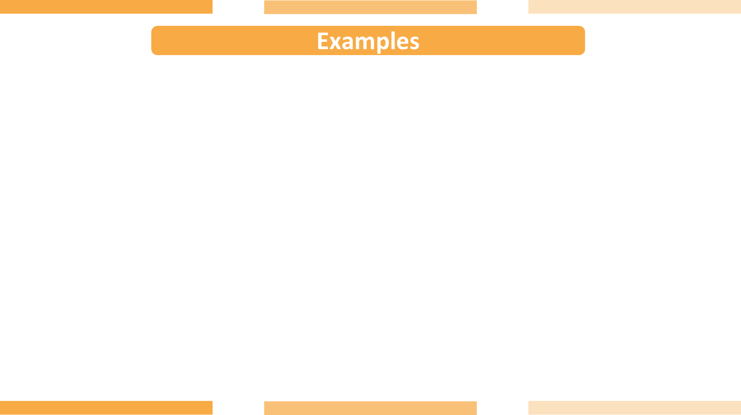
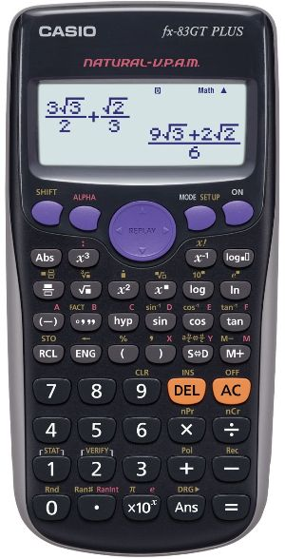
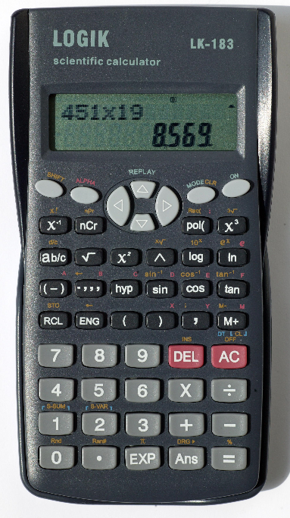

$$\text{Plenary}\text{ \%}$$
To find percentages of amounts.
This button simply divides (or multiplies) by 100 for you.
A couple to try:

